Slide 1
Text analytics to improve process automation at American Family Insurance
Andy Peters, PhD
Data Science & Machine Learning Manager

Slide 2
Talk Outline
The business problem: automating policy cancellations
Agent eForms, comments, and “actionability”
Statistical interactions and the importance of business follow-up
Our solutions
First pass: Bag-of-words + agent reason code
Random Forest
Gradient Boosting
Predicting correct reason code via neural networks
Word2Vec model
Convolutional Neural Net
Using NN results to improve actionability prediction
Next steps
Questions?

Slide 3
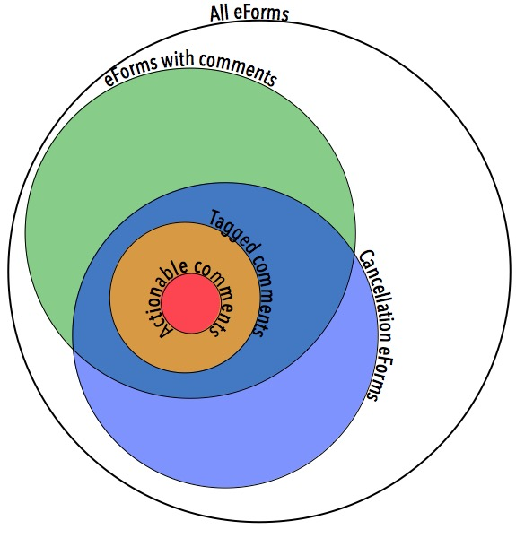
The business problem: Automating cancellation
When a customer wants to change a policy, it starts with the agent filling out an eForm online.
eForm is made up of various structured fields and a free-text Comments field.
Some of these comments are “actionable” (require some sort of follow-up)
American Family wants to improve efficiency by automating policy cancellations.
Can we identify those forms with actionable comments, and pass the rest to automation?

Slide 4
The data & the initial approach
Subject Matter Experts tagged ~15K comments as “Actionable” or “Not Actionable”
Binary target variable
Initial approach: “Bag-of-words” type model
Weighted frequencies (tf-idf) of words & bigrams as features

Slide 5
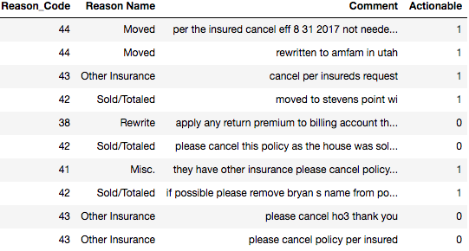
An unexpected interaction
Many “actionable” comments were flagged due to an incorrect reason code.
Comments that are acceptable under one reason code are not acceptable under another.
The interaction between reason code & comment is a key element of the prediction.
Both word frequencies and reason code were used as features.

Slide 6
Initial Model Results
Bag of Words model (weighted word frequencies – TF-IDF using 128 most frequent words/bigrams) + agent-assigned reason code
Random Forest & Gradient Boosting approaches (tuned via grid search & 10-fold cross-validation).
 | AUC |  | TP50
Model | Train | Test | Test
RF | 0.81 | 0.79 | 15.1%
GB | 0.93 | 0.84 | 13.2%

Slide 7
What if we just predict the correct reason code?
The approach:
Build a Word2Vec model to summarize word meaning.
Use much larger database of comments (508,000) to infer context of words.
Use Word2Vec vectors as input to a convolutional neural net to predict “correct” reason code.
Use neural network output as features in GB models to predict original target (actionable/non-actionable).

Slide 8
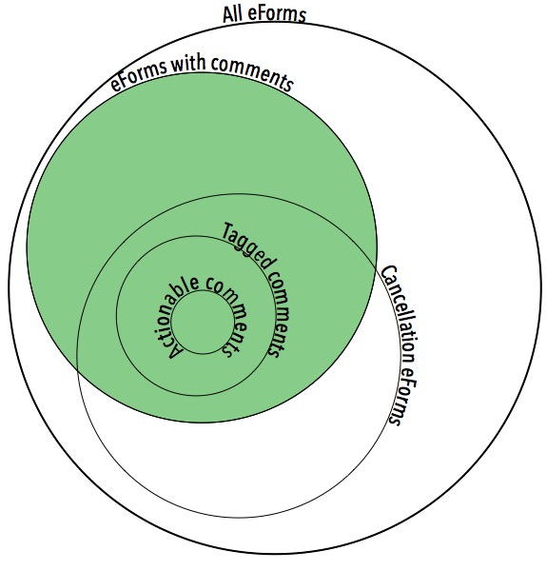
Word2Vec model
Word2Vec transforms discrete words into a continuous “context space.”
Because a Word2Vec model is built solely on text, we don’t need targets other than the words themselves.
Built a custom Word2Vec model to capture the unique terminology and jargon of an insurance company.
Trained using all eForm comments from 2017.

Slide 9
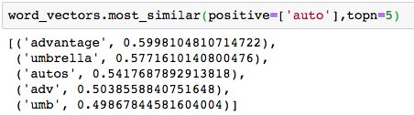
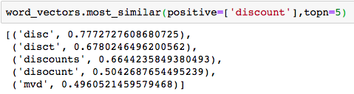
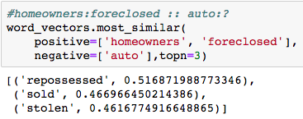
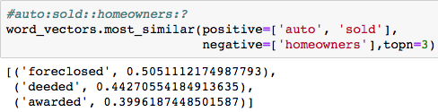
Word2Vec model
Word2Vec takes discrete words and places them into a continuous “context space” that allows the identification of similar words.

Slide 10
Predicting “correct” reason code using CNN’s
Replace words in comments with their Word2Vec vectors.
Only use cancellation comments we know to have the correct reason code.
Build model to categorize into correct code based on comments alone.
Model approach: 1D convolutional neural networks
Faster than RNN’s
Shown to be effective at classifying overall concepts within text

Slide 11
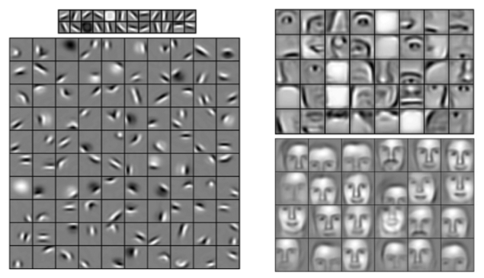
Convolutional Neural Networks & text
On images, CNN’s work by detecting low-level features, assembling them into higher-level features at each successive layer.
Lee et al., 200: Unsupervised learning of hierarchical representations with convolutional deep belief networks. Comm ACM 54:95

Slide 12
Convolutional Neural Networks & text
CNN’s work in a conceptually similar fashion on text, identifying low-level “features” based on Word2Vec scores of groups of words
A 1D Convolutional layer slides a window (“filter”) along a comment word by word (==vector by vector)
Our model uses three different filter sizes (3, 4, 5), with 2-3 layers of each, identifying low- and high-level conceptual “features”
Zhang, Y., & Wallace, B.; A Sensitivity Analysis of (and Practitioners' Guide to) Convolutional Neural Networks for Sentence Classification. arXiv:1510.03820

Slide 13
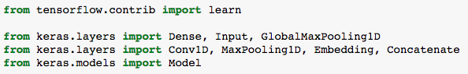
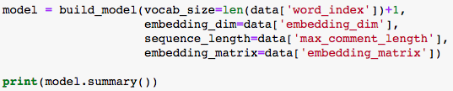
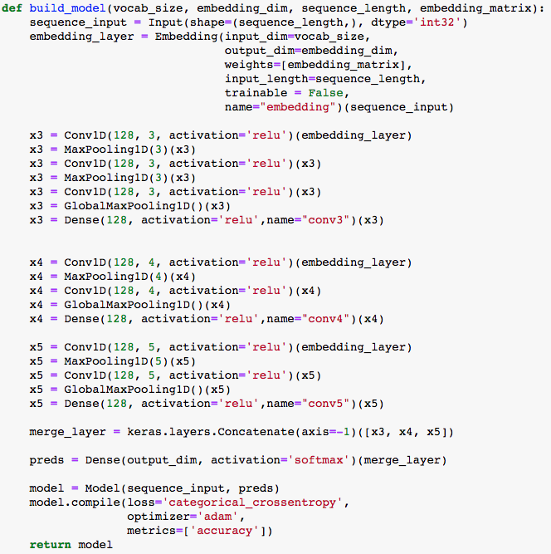
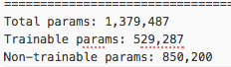
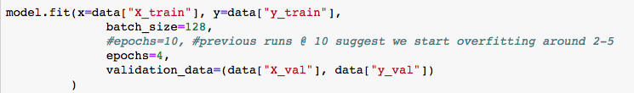
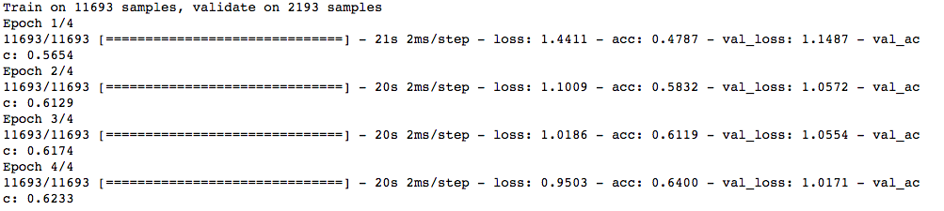
Building & training the CNN using TensorFlow/Keras
Dropout layers not shown to improve readability

Slide 14
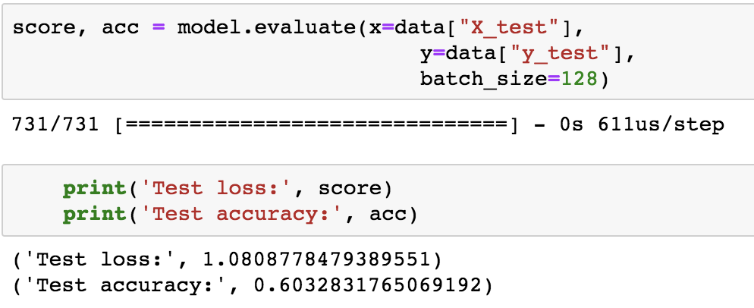
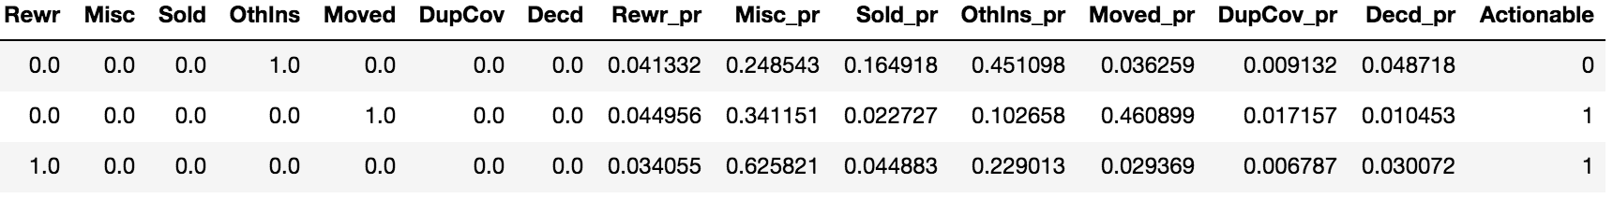
Code prediction model fits… okay
But we don’t necessarily want to use it to classify into correct codes.
What if we used the probability predictions of the reason codes, along with the originally assigned code, as features to predict the original target (actionable/non-actionable)?

Slide 15
The new approach
Introduce probability of each reason code as a feature in the Actionable / Non-actionable model
How predictive are models that include various combinations of:
Agent-assigned code
Predicted code
Original word frequencies
Word2Vec vector means

Slide 16
Code-versus-code model (Gradient Boosting)
Model with only original code and predicted probabilities of actual code (14 features) fits slightly better than original BoW model (135 features)
And might overfit slightly less
 | AUC |  | TP50
Model | Train | Test | Test
BoW | 0.93 | 0.84 | 13.2%
Codes | 0.93 | 0.86 | 9.3%

Slide 17
Squeezing out more predictive power
Some actionable comments were due to things other than code mismatches.
Can we improve on the “code-versus-code” model by adding the word frequencies back in?
 | AUC |  | TP50
Model | Train | Test | Test
Codes | 0.93 | 0.86 | 9.3%
Codes + BoW | 0.95 | 0.87 | 8.7%
Word frequencies improve prediction ever-so-slightly.
Can we take more advantage of the increased information density of Word2Vec?

Slide 18
She canna’ take much more
Word2Vec improves on BoW data by reducing sparsity and allowing for contextual similarity.
How might we summarize the W2V vectors of a comment?
Why not take the mean vector across all words?
 | AUC |  | TP50
Model | Train | Test | Test
Codes + BoW | 0.95 | 0.87 | 8.7%
Codes + Vector Means | 0.994 | 0.90 | 8.3%

Slide 19
Model summary
Adding features from Word2Vec and code predictions substantially improved the ability of our (already pretty good) model to predict actionable eForms.
Even though the code-prediction model has only 60% accuracy, it improves the model to predict the original target substantially.
Mean W2V vector approach gives a surprisingly good boost to the model.
 | AUC |  | TP50
Model | Train | Test | Test
BoW as RF | 0.81 | 0.79 | 15.1%
BoW as GB | 0.93 | 0.84 | 13.2%
Assigned vs. Predicted Codes | 0.93 | 0.86 | 9.3%
Codes + BoW | 0.95 | 0.87 | 8.7%
Codes + Vector Means | 0.994 | 0.90 | 8.3%

Slide 20
Business summary
Business insight that most actionable comments were due to code mismatches allowed us to:
Ensure we were including appropriate features from earliest stage of modeling.
Explore the power of combining a code-prediction model with the actionable/non-actionable model.
Quantifying the true-positive/false-positive tradeoff gave business partners the context they needed to prioritize their next steps.
Ultimately, incorrect reason code doesn’t directly affect the customer, so further effort to classify comments has low payoff.
Proof of concept of comment classification is likely to pay off for other types of change eForms.

Slide 21
Model next steps
Word2Vec model might be strengthened by bringing in other sources of insurance-specific text (claims notes; other technical communications).
More data might be available for code-classification model by matching eForm comments to final reason codes in our transactional databases.
eForms have historically been reviewed by experts prior to entering into the system.
Hyperparameters of all models (and Word2Vec and CNN architectures) should be more rigorously tuned.
Word2Vec + CNN approach is promising for other comment-classification tasks.

Slide 22

Questions?
Oh, and we’re hiring:
https://www.amfam.com/about/careers
Choose “Corporate Careers”
Search for “Data Scientist”
Notes:
x

